Slide 1
Parsel Hands-On Training
Tom Chuang, AAS SW
Created February 2011
Updated October 2012
Updated November 2014

Slide 2
Day 1 Start
Agenda
Install tools
Download framework
Download and Run Gen1.5 BLMC
Start TrainingApp

Slide 3
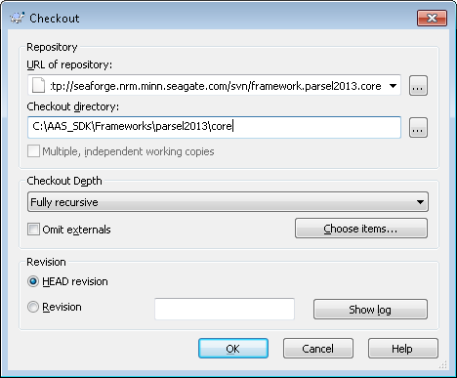
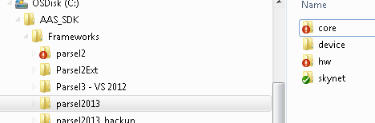
Install Tools and Setup Directory
Install TortoiseSVN: http://tortoisesvn.net/downloads.html
Create Directory Structure
C:\AAS_SDK
C:\AAS_SDK\Frameworks
C:\AAS_SDK\Frameworks\parsel2013
C:\AAS_SDK\Projects
Checkout from
http://seaforge.nrm.minn.seagate.com/svn/framework.parsel2013.core
To
C:\AAS_SDK\Frameworks\parsel2013\core
Repeat for
.device, .hw, and .skynet

Slide 4
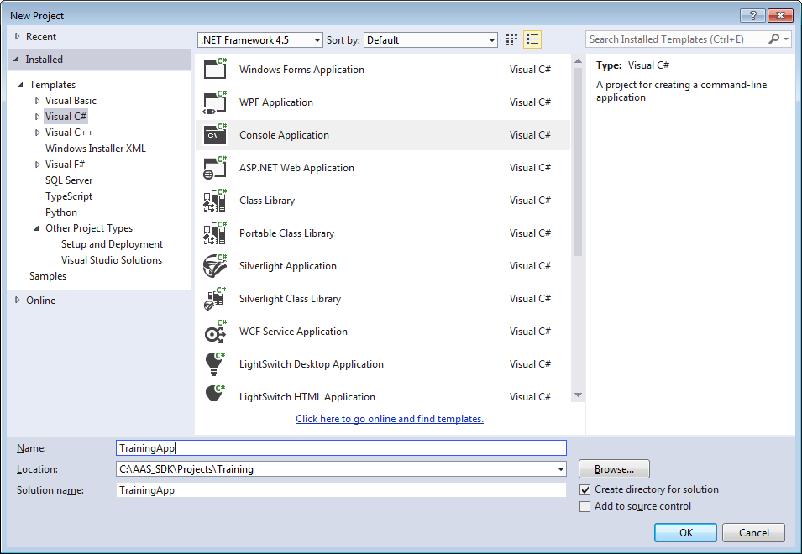
Create Application
File-New-Project
Select Project type: Visual C#
Select VS Template: Console Application
Specify directory: C:\AAS\Projects\Training
Specify Project Name: TrainingApp
Click OK

Slide 5
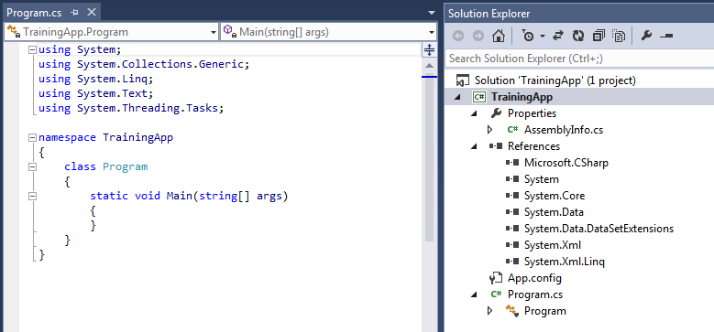
Review Creation
Directories, solution, and application created
Solution contains TrainingApp
TrainingApp contains
Program.cs
Basic .NET references
TrainingApp namespace

Slide 6
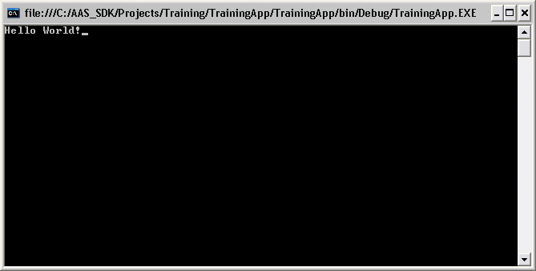
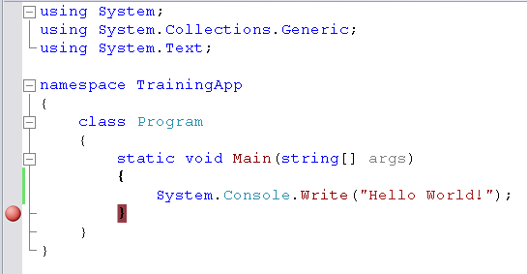
Make Hello World
Compile and Run by pressing F5
Add break point to view contents of console window
Write “Hello World!” to the console window.
Notes:
Note namespace

Slide 7
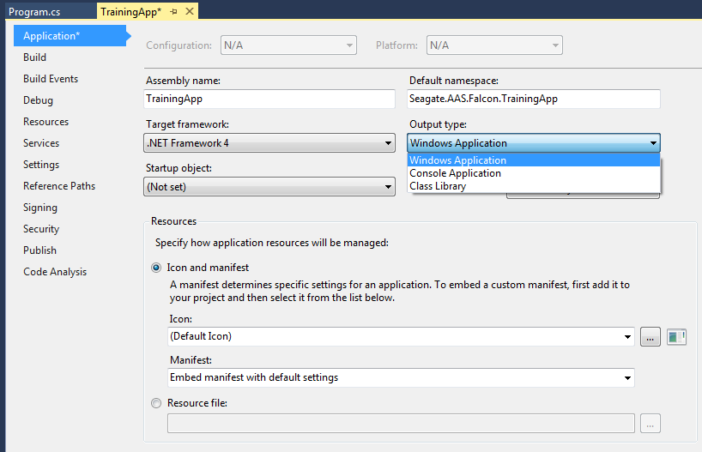
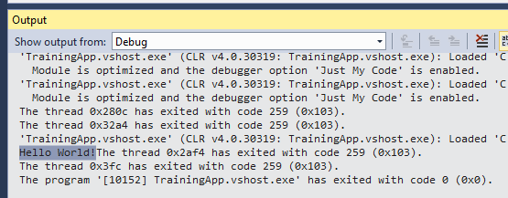
Change to Windows Application
Get Application Properties
Change Output type from Console to Windows Application
Change Default namespace to Seagate.AAS.Falcon.TrainingApp
Run (F5) and see console output in Output window
Notes:
Discuss importance of namespace to uniquely define names.

Slide 8
End of Day 1
Continue with Equipment Framework tomorrow

Slide 9
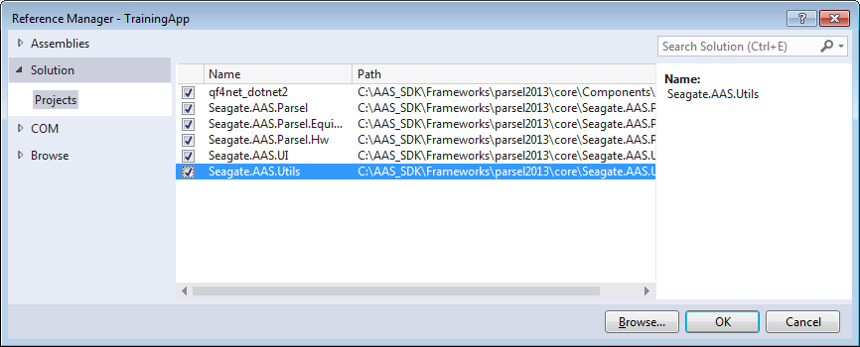
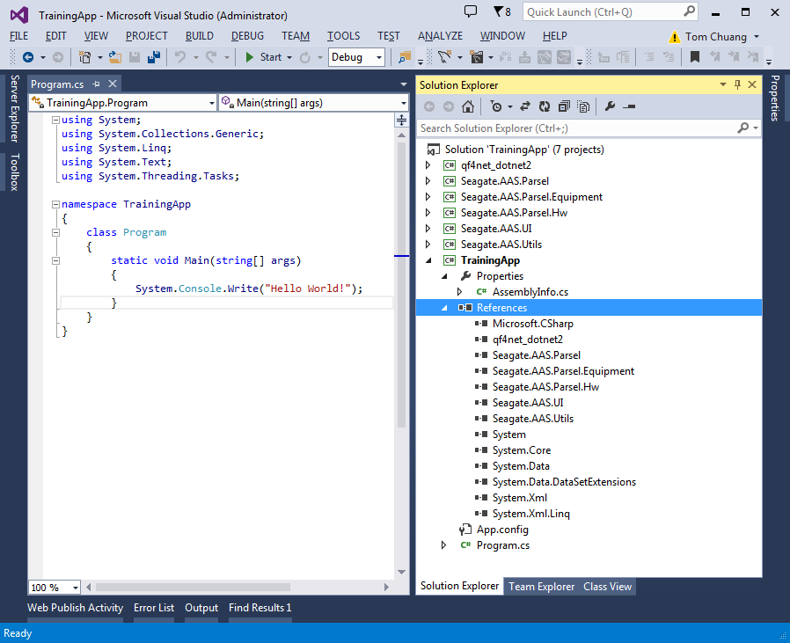
Add Projects and References
Start station development after learning about Machine and HwSystem
Add Projects
Seagate.AAS.UI
Seagate.AAS.Utils
Seagate.AAS.Parsel
Seagate.AAS.Parsel.Equipment
Seagate.AAS.Parsel.Hw
Components\qfnet_dotnet2
Add Project References to TrainingApp
Everything should compile (svn3)

Slide 10
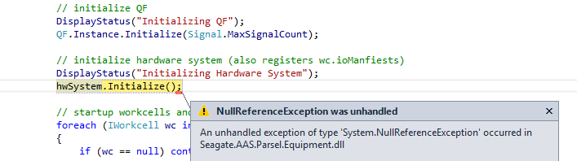
Create Machine
using System;
using System.Collections.Generic;
using System.Linq;
using System.Text;
namespace Seagate.AAS.Falcon.TrainingApp
{
class TrainingMachine : Seagate.AAS.Parsel.Equipment.Machine
{
private static TrainingMachine _instance = null;
public new static TrainingMachine Instance
{
get
{
if (_instance == null)
_instance = new TrainingMachine();
return _instance;
}
}
}
}
Add-New Item-Class: TrainingMachine
Inherit from Seagate.AAS.Parsel.Equipment.Machine
Add static Instance property with Singleton pattern.
Add TrainingMachine.Instance.Launch() to Program.cs
Change Program.cs namesapce to Seagate.AAS.Falcon.TrainingApp
Try to run. See splash screen and need for HwSystem
namespace Seagate.AAS.Falcon.TrainingApp
{
class Program
{
static void Main(string[] args)
{
System.Console.Write("Hello World!");
TrainingMachine.Instance.Launch();
}
}
}

Slide 11
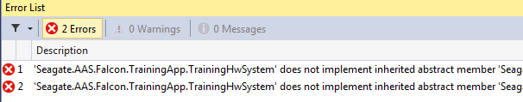
Create HwSystem
Add-New Item-Class: TrainingHwSystem
Inherit from Seagate.AAS.Parsel.Hw.HwSystem
Compile
See missing abstract members from IHwSystem
Right click on HwSystem and select Implement Abstract Class.
Create TrainingMachine constructor and instantiate hwSystem
using System;
using System.Collections.Generic;
using System.Linq;
using System.Text;
namespace Seagate.AAS.Falcon.TrainingApp
{
class TrainingHwSystem : Seagate.AAS.Parsel.Hw.HwSystem
{
public override void RegisterHwComponents()
{
//throw new NotImplementedException();
}
public override void InitializeHwComponents()
{
//throw new NotImplementedException();
}
}
}
using System;
using System.Collections.Generic;
using System.Linq;
using System.Text;
namespace Seagate.AAS.Falcon.TrainingApp
{
class TrainingMachine : Seagate.AAS.Parsel.Equipment.Machine
{
private static TrainingMachine _instance = null;
public new static TrainingMachine Instance
{
get
{
if (_instance == null)
_instance = new TrainingMachine();
return _instance;
}
}
public TrainingMachine()
{
this.hwSystem = new TrainingHwSystem();
}
}
}

Slide 12
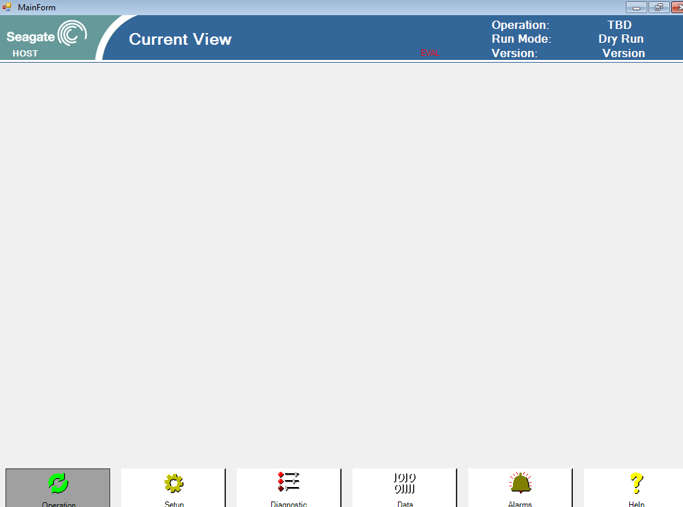
Modify Machine.Launch
namespace Seagate.AAS.Falcon.TrainingApp
{
class TrainingMachine : Seagate.AAS.Parsel.Equipment.Machine
{
private static TrainingMachine _instance = null;
public new static TrainingMachine Instance
{
get
{
if (_instance == null)
_instance = new TrainingMachine();
return _instance;
}
}
public TrainingMachine()
{
this.hwSystem = new TrainingHwSystem();
}
public override void Launch()
{
base.Launch();
System.Windows.Forms.Application.Run(new Seagate.AAS.Parsel.Equipment.FormMainE95());
base.Shutdown();
}
}
}
Run (F5). No UI!
Create UI
Add System.Windows.Form reference to project
In TrainingMachine, override Machine.Launch()
Add base.Launch()
Add FormMainLite
System.Windows.Forms.Application.Run(new Seagate.AAS.Parsel.Equipment.FormMainLite());
Add base.Shutdown()
Compile and run. See plain UI!
Change to FormMainE95
Compile and run. See fancier UI!
Note Shutdown behavior

Slide 13
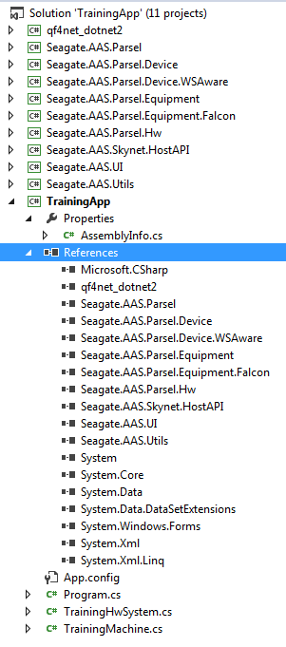
FOF Workcell
For this training, we are making a new Falcon station
We can leverage existing Equipment.Falcon framework
Add project Seagate.AAS.Parsel.Equipment.Falcon
Also add the following because of dependency
Seagate.AAS.Parsel.Device
Seagate.AAS.Parsel.Device.WSAware
Seagate.AAS.Skynet.HostAPI
Add reference to these projects in TrainingApp

Slide 14
TrainingWorkcell
using System;
using System.Collections.Generic;
using System.Linq;
using System.Text;
namespace Seagate.AAS.Falcon.TrainingApp
{
class TrainingWorkcell : Seagate.AAS.Parsel.Equipment.Falcon.FalconWorkcell
{
public TrainingWorkcell()
{
this.name = "TWC";
this.slotName = "TWC";
}
public override void Initialize()
{
//throw new NotImplementedException();
}
public override Parsel.Hw.IOManifest IOManifest
{
//get { throw new NotImplementedException(); }
}
}
}
namespace Seagate.AAS.Falcon.TrainingApp
{
class TrainingMachine : Seagate.AAS.Parsel.Equipment.Machine
{
private static TrainingMachine _instance = null;
TrainingWorkcell _workcell = null;
public TrainingWorkcell Workcell
{
get { return _workcell; }
}
public new static TrainingMachine Instance
{
get
{
if (_instance == null)
_instance = new TrainingMachine();
return _instance;
}
}
public TrainingMachine()
{
this.hwSystem = new TrainingHwSystem();
}
public override void Launch()
{
base.Launch();
System.Windows.Forms.Application.Run(new Seagate.AAS.Parsel.Equipment.FormMainE95());
base.Shutdown();
}
public override void Startup()
{
_workcell = new TrainingWorkcell();
RegisterWorkcell(_workcell);
base.Startup();
}
}
}
Create workcell: TrainingWorkcell.cs
Inherit from FalconWorkcell
Implement Abstract Class
IoManifest property
Just return null for now
Initialize method
Comment out exception
Add Constructor
Assign workcell name and slotname: TWC
Instantiate workcell in TrainingMachine
Create workcell member and property
Override Startup()
Instantiate TrainingWorkcell
Register workcell by calling RegisterWorkcell()
Call base.Startup()

Slide 15
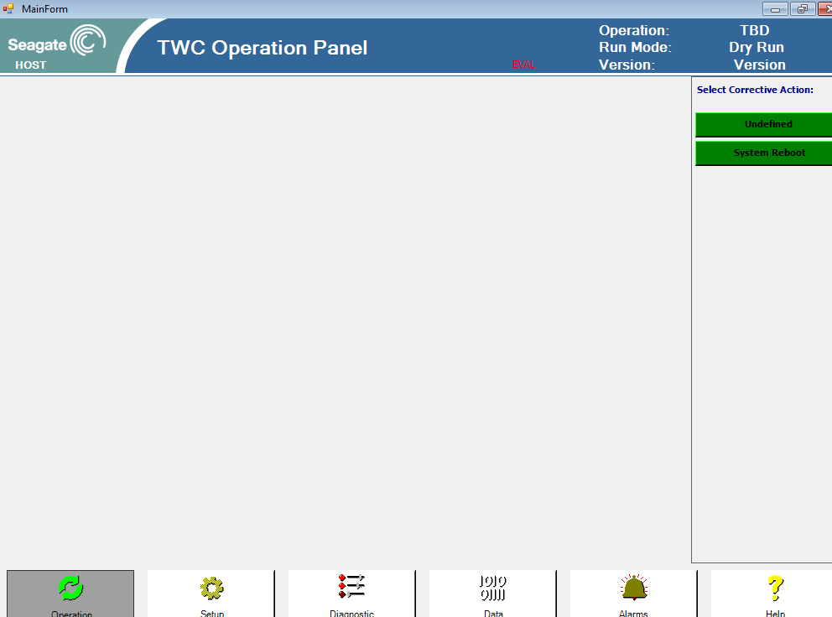
Test Machine and Workcell
Run (F5)…
Note how UI changes when you press navigation buttons.
There are default versions of the operation, setup, diagnostic, and data panels.
Start/Stop/Pause buttons on command panel.
Title displays current panel.
OEE Interface!

Slide 16
End of Day 2
Continue with ActiveProcess tomorrow

Slide 17
Day 3 Start: Design Process
Begin with activity diagram
A block diagram that describes what the equipment is suppose to do
Define Active Processes
Identify processes that must operate in its own thread of execution.
Minimize number of Active Processes whenever possible.
Activity diagram may help organize your thoughts here.
Draw State Diagram for Each Active Process
Identify and Name Transitions
Code Workcell
A Class Library that implements IWorkCell
Active Processes
Derive from base ActiveProcess class.
Reference Viper Software QuickStart.pdf

Slide 18
Activity Diagram
First use activity diagram to describe equipment behavior.
For simple pick and place operation:
Pick Part
Place Part
Wait for Drive
Release Drive

Slide 19
Activity Diagram
Next group activities that should happen as independent sequences
“Robot”
Pick Part
Place Part
join
split
“Conveyor”
Wait for Drive
Release Drive

Slide 20
Convert to State Machines
Take activities
Imagine as states
Convert Joins into Wait States
Redraw into state diagram

Slide 21
Conveyor Active Process
UML legend
Solid circle is start
Bubbles are states
Arrows are events
Initialize
Get next drive
Wait place done
Drive Ready
Release drive
Part placed

Slide 22
Robot Active Process
UML legend:
Solid circle is start
Bubbles are states
Arrows are events
Initialize
Pick part from feeder
Wait drive ready
Place part
Part placed
Drive Ready

Slide 23
Code basic Active Processes
using System;
using System.Collections.Generic;
using System.Linq;
using System.Text;
namespace Seagate.AAS.Falcon.TrainingApp
{
public class Robot : Seagate.AAS.Parsel.Equipment.ActiveProcess
{
TrainingWorkcell _workcell;
public Robot(TrainingWorkcell workcell)
: base(workcell)
{
_workcell = workcell;
}
}
}
using System;
using System.Collections.Generic;
using System.Linq;
using System.Text;
namespace Seagate.AAS.Falcon.TrainingApp
{
public class Conveyor : Seagate.AAS.Parsel.Equipment.ActiveProcess
{
TrainingWorkcell _workcell;
public Conveyor(TrainingWorkcell workcell)
: base(workcell)
{
_workcell = workcell;
}
}
}
Create Conveyor and Robot Active Process
Make class public
Inherit from Seagate.AAS.Parsel.Equipment.ActiveProcess
Implement constructor and store workcell reference (Injection pattern)
HINT. Can just copy file and rename.
Register Active Processes in Workcell.Initialize()
Add the following:
activeProcesses.Add(“Conveyor”,new Conveyor(this));
activeProcesses.Add(“Robot”,new Robot(this));
Also add property interface (for use later)
namespace Seagate.AAS.Falcon.TrainingApp
{
class TrainingWorkcell : Seagate.AAS.Parsel.Equipment.Falcon.FalconWorkcell
{
public TrainingWorkcell()
{
this.name = "TWC";
this.slotName = "TWC";
}
public override void Initialize()
{
activeProcesses.Add("Conveyor", new Conveyor(this));
activeProcesses.Add("Robot", new Robot(this));
}
public override Parsel.Hw.IOManifest IOManifest
{
get
{
return null;
}
}
}
}

Slide 24
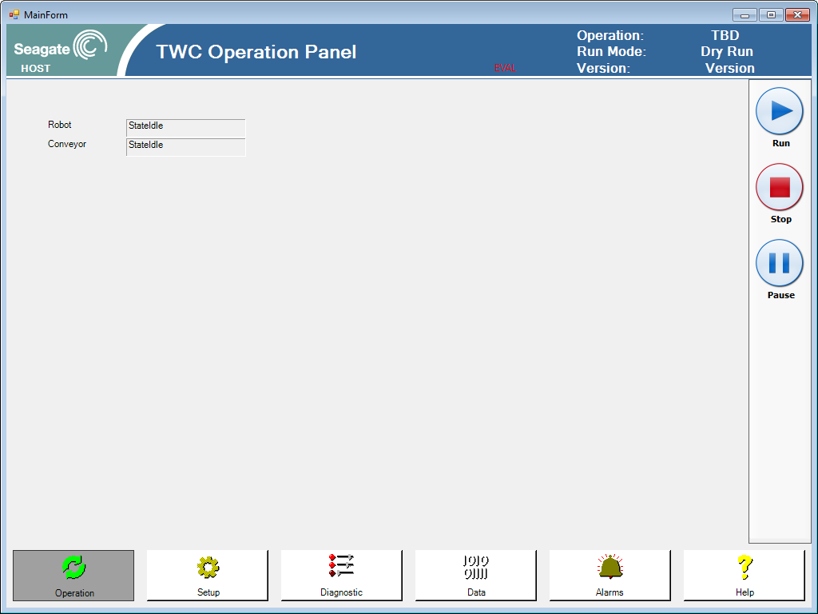
Test
Run (F5)…
Notice changes to operational panel
Push the run/stop/pause buttons
Questions:
Why does the state machine work already?
State labels automatic appeared. How does this work?

Slide 25
End Day 3 part 1

Slide 26
Code Conveyor States
using System;
using System.Collections.Generic;
using System.Linq;
using System.Text;
using qf4net;
namespace Seagate.AAS.Falcon.TrainingApp
{
public class Conveyor : Seagate.AAS.Parsel.Equipment.ActiveProcess
{
TrainingWorkcell _workcell;
private QState stateGetNextDrive;
private QState stateWaitPlaceDone;
private QState stateReleaseDrive;
public Conveyor(TrainingWorkcell workcell)
: base(workcell)
{
_workcell = workcell;
stateGetNextDrive = new QState(this.GetNextDrive );
stateWaitPlaceDone = new QState(this.WaitPlaceDone);
stateReleaseDrive = new QState(this.ReleaseDrive );
}
protected override QState StateRunInit(qf4net.IQEvent qEvent)
{
if (qEvent.IsSignal(SigStateJob))
{
TransitionTo(stateGetNextDrive);
return null;
}
return stateProcess;
}
protected QState GetNextDrive(qf4net.IQEvent qEvent)
{
if (qEvent.IsSignal(SigStateJob))
{
TransitionTo(stateWaitPlaceDone);
return null;
}
return stateProcess;
}
protected QState WaitPlaceDone(qf4net.IQEvent qEvent)
{
if (qEvent.IsSignal(SigStateJob))
{
TransitionTo(stateReleaseDrive);
return null;
}
return stateProcess;
}
protected QState ReleaseDrive(qf4net.IQEvent qEvent)
{
if (qEvent.IsSignal(SigStateJob))
{
TransitionTo(stateGetNextDrive);
return null;
}
return stateProcess;
}
}
}
Start with Conveyor
Refer to Conveyor state diagram
Add namespace to save typing: “using qf4net;”
Code states:
Override RunInit to define initial state entry
Define Run states
GetNextDrive
WaitPlaceDone
ReleaseDrive
Initialize state method references in constructor
HINT: Recognize pattern. Then copy and paste.

Slide 27

Test
Run (F5) …
Notice
New conveyor run states
Behavioral Inheritance
Automatically expands run behavior
Automatically starts and stops

Slide 28
Code Robot States
using System;
using System.Collections.Generic;
using System.Linq;
using System.Text;
using qf4net;
namespace Seagate.AAS.Falcon.TrainingApp
{
public class Robot : Seagate.AAS.Parsel.Equipment.ActiveProcess
{
TrainingWorkcell _workcell;
private QState statePickPart;
private QState stateWaitDriveReady;
private QState statePlacePart;
public Robot(TrainingWorkcell workcell)
: base(workcell)
{
_workcell = workcell;
statePickPart = new QState(this.PickPart);
stateWaitDriveReady = new QState(this.WaitDriveReady);
statePlacePart = new QState(this.PlacePart);
}
protected override QState StateRunInit(qf4net.IQEvent qEvent)
{
if (qEvent.IsSignal(SigStateJob))
{
TransitionTo(statePickPart);
return null;
}
return stateProcess;
}
protected QState PickPart(qf4net.IQEvent qEvent)
{
if (qEvent.IsSignal(SigStateJob))
{
TransitionTo(stateWaitDriveReady);
return null;
}
return stateProcess;
}
protected QState WaitDriveReady(qf4net.IQEvent qEvent)
{
if (qEvent.IsSignal(SigStateJob))
{
TransitionTo(statePlacePart);
return null;
}
return stateProcess;
}
protected QState PlacePart(qf4net.IQEvent qEvent)
{
if (qEvent.IsSignal(SigStateJob))
{
TransitionTo(statePickPart);
return null;
}
return stateProcess;
}
}
}
Add namespace to save typing: “using qf4net;”
Code states:
Override RunInit to define initial state entry
Define Run states
PickPart
WaitDriveReady
PlacePart
Initialize state method references in constructor
HINT: copy code from Conveyor and use refactor.

Slide 29

Test
Run (F5) …
Notice
New robot run states
Robot and Conveyor are running independent of each other
Next add synchronization

Slide 30
End Day 3 part 2

Slide 31
Signals and Synchronization
We’ve coded states and state transitions so far
State machines communicate with signals
Initialize
Initialize
Get next drive
Drive Ready
Wait place done
Pick part from feeder
Wait drive ready
Release drive
Place part
Part placed
Drive Ready
Part placed

Slide 32
Signals and Synchronization
Our simple state machines uses two signals
DriveReady
PartPlaced
Initialize
Initialize
Get next drive
Drive Ready
Wait place done
Pick part from feeder
Wait drive ready
Release drive
Place part
Part placed
Drive Ready
Part placed

Slide 33
Code Signals
using System;
using System.Collections.Generic;
using System.Linq;
using System.Text;
using qf4net;
namespace Seagate.AAS.Falcon.TrainingApp
{
public class TrainingSignals
{
public static readonly Signal DriveReady = new Signal("Drive Ready");
public static readonly Signal PartPlaced = new Signal("PartPlaced ");
}
}
Add TrainingSignals.cs class
Add using qf4net;
Make class public
Add public static readonly Signal xxx = new Signal(“xxx”)
In TrainingWorkcell.cs
Instantiate TrainingSignals member variable
using System;
using System.Collections.Generic;
using System.Linq;
using System.Text;
namespace Seagate.AAS.Falcon.TrainingApp
{
public class TrainingWorkcell : Seagate.AAS.Parsel.Equipment.Falcon.FalconWorkcell
{
TrainingSignals trainingSignals = new TrainingSignals();
public TrainingWorkcell()
{
this.name = "TWC";
this.slotName = "TWC";
}
public override void Initialize()
{
activeProcesses.Add("Conveyor", new Conveyor(this));
activeProcesses.Add("Robot", new Robot(this));
}
public override Parsel.Hw.IOManifest IOManifest
{
get
{
return null;
}
}
}
}

Slide 34
Register and Publish Signals
using System;
using System.Collections.Generic;
using System.Linq;
using System.Text;
using qf4net;
namespace Seagate.AAS.Falcon.TrainingApp
{
public class Conveyor : Seagate.AAS.Parsel.Equipment.ActiveProcess
{
TrainingWorkcell _workcell;
private QState stateGetNextDrive;
private QState stateWaitPlaceDone;
private QState stateReleaseDrive;
public Conveyor(TrainingWorkcell workcell)
: base(workcell)
{
_workcell = workcell;
stateGetNextDrive = new QState(this.GetNextDrive );
stateWaitPlaceDone = new QState(this.WaitPlaceDone);
stateReleaseDrive = new QState(this.ReleaseDrive );
}
protected override void InitializeStateMachine()
{
QF.Instance.Subscribe(this, TrainingSignals.PartPlaced);
base.InitializeStateMachine();
}
protected override QState StateRunInit(qf4net.IQEvent qEvent)
{
if (qEvent.IsSignal(SigStateJob))
{
TransitionTo(stateGetNextDrive);
return null;
}
return stateProcess;
}
protected QState GetNextDrive(qf4net.IQEvent qEvent)
{
LogMessage("GetNextDrive", qEvent);
if (qEvent.IsSignal(SigStateJob))
{
LogMessage("*** publish DriveReady);
QF.Instance.Publish(new QEvent(TrainingSignals.DriveReady));
TransitionTo(stateWaitPlaceDone);
return null;
}
return stateProcess;
}
protected QState WaitPlaceDone(qf4net.IQEvent qEvent)
{
if (qEvent.IsSignal(SigStateJob))
{
TransitionTo(stateReleaseDrive);
return null;
}
return stateProcess;
}
protected QState ReleaseDrive(qf4net.IQEvent qEvent)
{
if (qEvent.IsSignal(SigStateJob))
{
TransitionTo(stateGetNextDrive);
return null;
}
return stateProcess;
}
}
}
In Conveyor
Override InitializeStateMachine
Subscribe to receive PartPlaced signal
Publish DriveReady signal
In Robot
Override InitializeStateMachine
Subscribe to receive DriveReady signal
Publish PartPlaced signal
In Both
Add LogMessages to see state transtions
NOTE:
Publish and Subscribe design pattern
using System;
using System.Collections.Generic;
using System.Linq;
using System.Text;
using qf4net;
namespace Seagate.AAS.Falcon.TrainingApp
{
public class Robot : Seagate.AAS.Parsel.Equipment.ActiveProcess
{
TrainingWorkcell _workcell;
private QState statePickPart;
private QState stateWaitDriveReady;
private QState statePlacePart;
public Robot(TrainingWorkcell workcell)
: base(workcell)
{
_workcell = workcell;
statePickPart = new QState(this.PickPart);
stateWaitDriveReady = new QState(this.WaitDriveReady);
statePlacePart = new QState(this.PlacePart);
}
protected override void InitializeStateMachine()
{
QF.Instance.Subscribe(this, TrainingSignals.DriveReady);
base.InitializeStateMachine();
}
protected override QState StateRunInit(qf4net.IQEvent qEvent)
{
if (qEvent.IsSignal(SigStateJob))
{
TransitionTo(statePickPart);
return null;
}
return stateProcess;
}
protected QState PickPart(qf4net.IQEvent qEvent)
{
if (qEvent.IsSignal(SigStateJob))
{
TransitionTo(stateWaitDriveReady);
return null;
}
return stateProcess;
}
protected QState WaitDriveReady(qf4net.IQEvent qEvent)
{
if (qEvent.IsSignal(SigStateJob))
{
TransitionTo(statePlacePart);
return null;
}
return stateProcess;
}
protected QState PlacePart(qf4net.IQEvent qEvent)
{
LogMessage("PlacePart", qEvent);
if (qEvent.IsSignal(SigStateJob))
{
LogMessage("*** publish PartPlaced”);
QF.Instance.Publish(new QEvent(TrainingSignals.PartPlaced));
TransitionTo(statePickPart);
return null;
}
return stateProcess;
}
}
}

Slide 35
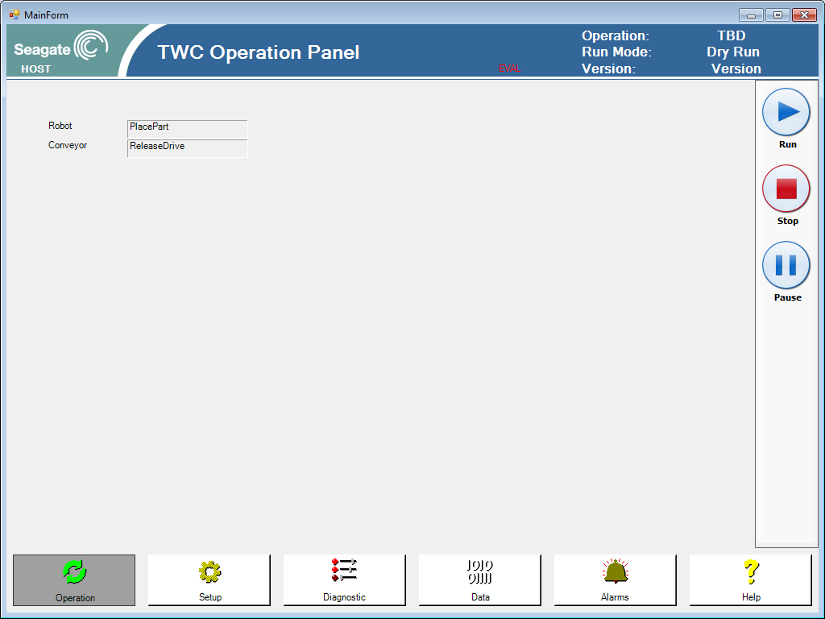
Test
Run (F5) …
Note
Look at debug output for state change sequence
State machine still not synchronized
Next
Make state machines wait for signals
Seagate.AAS.Falcon.TrainingApp.Conveyor-47242236: *** publish DriveReady
Seagate.AAS.Falcon.TrainingApp.Robot-3132301: Enter PlacePart
Seagate.AAS.Falcon.TrainingApp.Conveyor-47242236: Exit GetNextDrive
Seagate.AAS.Falcon.TrainingApp.Conveyor-47242236: Enter GetNextDrive
Seagate.AAS.Falcon.TrainingApp.Conveyor-47242236: *** publish DriveReady
Seagate.AAS.Falcon.TrainingApp.Conveyor-47242236: Exit GetNextDrive
Seagate.AAS.Falcon.TrainingApp.Conveyor-47242236: Enter GetNextDrive
Seagate.AAS.Falcon.TrainingApp.Robot-3132301: *** publish PartPlaced
Seagate.AAS.Falcon.TrainingApp.Conveyor-47242236: *** publish DriveReady
Seagate.AAS.Falcon.TrainingApp.Robot-3132301: Exit PlacePart
Seagate.AAS.Falcon.TrainingApp.Robot-3132301: Enter PlacePart
Seagate.AAS.Falcon.TrainingApp.Conveyor-47242236: Exit GetNextDrive
Seagate.AAS.Falcon.TrainingApp.Robot-3132301: *** publish PartPlaced
Seagate.AAS.Falcon.TrainingApp.Conveyor-47242236: Enter GetNextDrive
Seagate.AAS.Falcon.TrainingApp.Conveyor-47242236: *** publish DriveReady
Seagate.AAS.Falcon.TrainingApp.Conveyor-47242236: Exit GetNextDrive
Seagate.AAS.Falcon.TrainingApp.Conveyor-47242236: Enter GetNextDrive
Seagate.AAS.Falcon.TrainingApp.Robot-3132301: Exit PlacePart

Slide 36
End Day 3 part 3

Slide 37
Wait for Signals
Conveyor.cs…
protected QState WaitPlaceDone(qf4net.IQEvent qEvent)
{
LogMessage("WaitPlaceDone", qEvent);
if (qEvent.IsSignal(TrainingSignals.PartPlaced))
{
TransitionTo(stateReleaseDrive);
return null;
}
return stateProcess;
}
In Conveyor
Change WaitPartPlaced state’s test of signal from SigStateJob to TrainingSignals.PartPlace
In Robot
Change WaitDriveReady state’s test of signal from SigStateJob to TrainingSignals.DriveReady
Robot.cs…
protected QState WaitDriveReady(qf4net.IQEvent qEvent)
{
if (qEvent.IsSignal(TrainingSignals.DriveReady))
{
TransitionTo(statePlacePart);
return null;
}
return stateProcess;
}

Slide 38

Test
Run (F5) …
State machine gets locked up now. Discuss.
Signals are delivered by events
Events occur in an instance in time and then are done
State machines
Run independently
Have no knowledge of each other’s state
Next
Add deferred signal capability

Slide 39
Deferred Signals
Conveyor.cs…
protected override QState StateActive(IQEvent qEvent)
{
if (qEvent.IsSignal(TrainingSignals.PartPlaced))
{
AddDeferredSignal(qEvent);
return null;
}
return base.StateActive(qEvent);
}
protected QState WaitPlaceDone(qf4net.IQEvent qEvent)
{
LogMessage("WaitPlaceDone", qEvent);
if (qEvent.IsSignal(SigStateJob))
{
RecallDeferredSignal(TrainingSignals.PartPlaced);
return null;
}
if (qEvent.IsSignal(TrainingSignals.PartPlaced))
{
LogMessage("*** received PartPlaced");
TransitionTo(stateReleaseDrive);
return null;
}
return stateProcess;
}
For Conveyor.cs & Robot.cs
Override StateActive
Record signals from events that bubble up to this state
When waiting for a signal, recall deferred signals first.
Add more log messages in wait states
Robot.cs…
protected QState WaitDriveReady(qf4net.IQEvent qEvent)
{
if (qEvent.IsSignal(TrainingSignals.DriveReady))
{
TransitionTo(statePlacePart);
return null;
}
return stateProcess;
}
protected QState WaitDriveReady(qf4net.IQEvent qEvent)
{
if (qEvent.IsSignal(SigStateJob))
{
RecallDeferredSignal(TrainingSignals.DriveReady);
return null;
}
if (qEvent.IsSignal(TrainingSignals.DriveReady))
{
LogMessage("*** received DriveReady");
TransitionTo(statePlacePart);
return null;
}
return stateProcess;
}

Slide 40

Test
Run (F5) …
Note
State machines are synchronized!
Stop Event
Pushing Stop button publishes Stop Event
Currently, Stop Event immediately exits run state
Can defer Stop Event so key operations are completed first
Extra Credit: Tell me how this can be done
Next
Hardware
Hardware Providers, IoManifest, Controllers, Devices

Slide 41
End Day 3 part 4

Slide 42
Start Day 4
We will cover hardware topics today
Hardware Providers
IoManifest
Controllers
Devices

Slide 43
Hardware Abstraction
Recall hardware abstraction and relationship between objects
Machine
Workcell
Conveyor
Robot
Controller
Controller
IoManifest
HwSystem
Copley

Slide 44
Hardware Abstraction
We will add hardware capability to our exercise
Use the Copley hardware provider.
Create IoManifest to register all the IO points our workcell uses.
Create controllers with macro functions
Create diagnostic UI

Slide 45
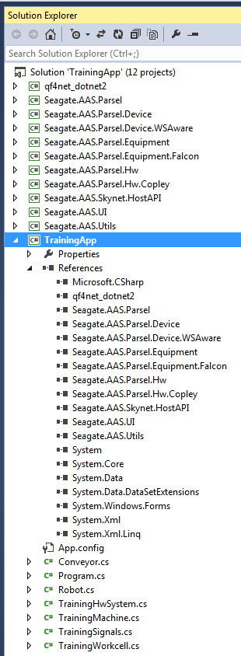
Hardware Provider
Edit Solution
Add Hw.Copley project
Note 32 vs 64 bit reference
Edit TrainingApp project
Add reference to Hw.Copley
Edit HwSystem
Add Seagate.AAS.Parsel.Hw.Copley.CopleyHC member variable
Instantiate and register in RegisterHwComponent
Initialize in InitializeHwComponents
Optional: enumerate Hw component
using System;
using System.Collections.Generic;
using System.Linq;
using System.Text;
namespace Seagate.AAS.Falcon.TrainingApp
{
class TrainingHwSystem : Seagate.AAS.Parsel.Hw.HwSystem
{
Seagate.AAS.Parsel.Hw.Copley.CopleyHC copley = null;
public override void RegisterHwComponents()
{
copley = new Parsel.Hw.Copley.CopleyHC("kvaser0");
RegisterHwComponent(copley, 0, "Copley");
}
public override void InitializeHwComponents()
{
GetHwComponent(0).Initialize(true);
}
}
}

Slide 46
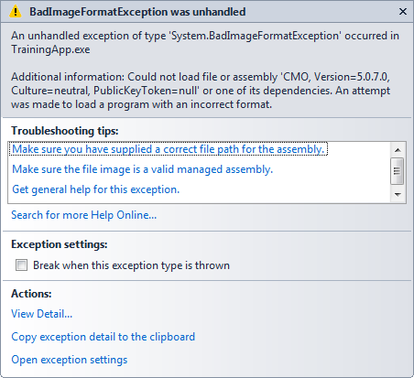

Test
Run (F5) …
Note:
Nothing new to see visibly
May see exception related to copley bitness
Change TrainingApp to x86 if necessary
Next
Create Diagnostic UI

Slide 47
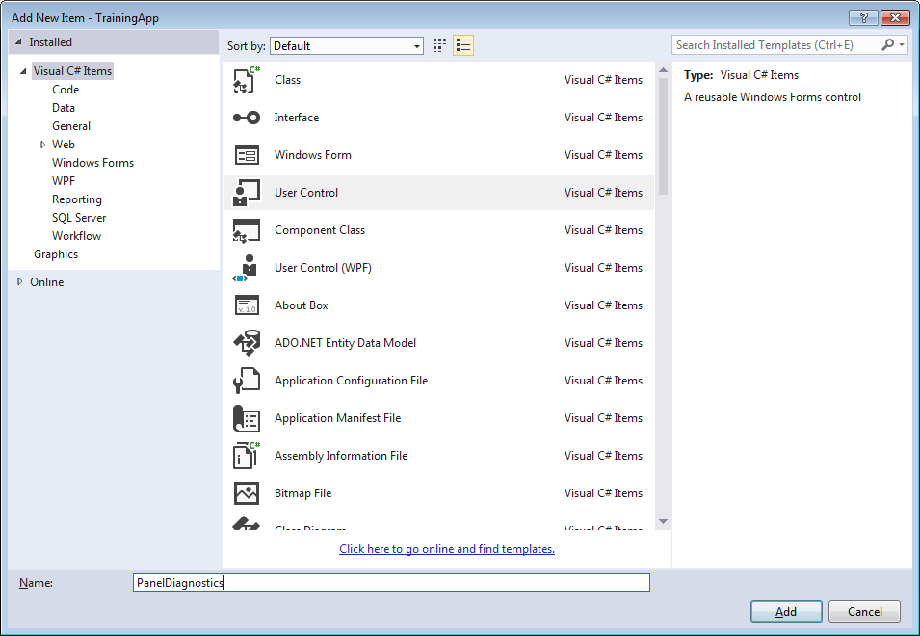
PanelDiagnostics
using System;
using System.Collections.Generic;
using System.ComponentModel;
using System.Drawing;
using System.Data;
using System.Linq;
using System.Text;
using System.Windows.Forms;
namespace Seagate.AAS.Falcon.TrainingApp
{
public partial class PanelDiagnostics : UserControl
{
TrainingWorkcell workcell;
public PanelDiagnostics(TrainingWorkcell workcell)
{
InitializeComponent();
this.workcell = workcell;
Seagate.AAS.Parsel.Hw.Copley.CopleyHC copley = (Seagate.AAS.Parsel.Hw.Copley.CopleyHC)TrainingMachine.Instance.HwSystem.GetHwComponent(0);
panelIOListTouchscreen1.AssignCopleyHC(copley);
}
}
}
Create PanelDiagnostics.cs
Add UserControl…
Drop in Copley.PanelIOListTouchscreen
Inject workcell reference to PanelDiagnostics
Inject Copley reference to PanelIoListTouchscreen
In Workcell
Override DiagnosticPanel property to return our diagnostic panel singleton
using System;
using System.Collections.Generic;
using System.Linq;
using System.Text;
namespace Seagate.AAS.Falcon.TrainingApp
{
public class TrainingWorkcell : Seagate.AAS.Parsel.Equipment.Falcon.FalconWorkcell
{
TrainingSignals trainingSignals = new TrainingSignals();
PanelDiagnostics _panelDiagnostics = null;
public override System.Windows.Forms.UserControl DiagnosticPanel
{
get
{
if (_panelDiagnostics == null)
_panelDiagnostics = new PanelDiagnostics(this);
return _panelDiagnostics;
}
}
public TrainingWorkcell()
{
this.name = "TWC";
this.slotName = "TWC";
}
public override void Initialize()
{
activeProcesses.Add("Conveyor", new Conveyor(this));
activeProcesses.Add("Robot", new Robot(this));
}
public override Parsel.Hw.IOManifest IOManifest
{
get
{
return null;
}
}
}
}

Slide 48
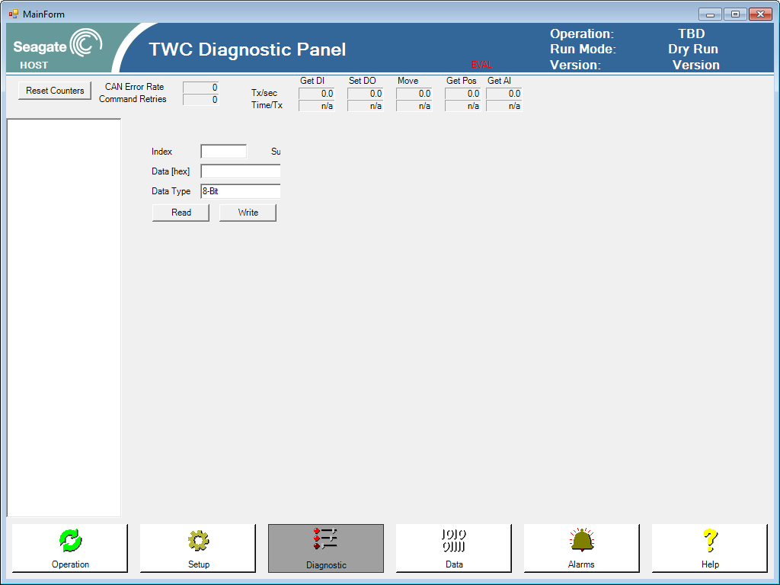
Test
Run (F5) …
Note:
DiagnosticPanel appears but no IO points (yet)
Next
Create IoManifest

Slide 49
End Day 4 part 1

Slide 50
IoManifest
using System;
using System.Collections.Generic;
using System.Linq;
using System.Text;
namespace Seagate.AAS.Falcon.TrainingApp
{
public class TrainingIoManifest : Seagate.AAS.Parsel.Hw.IOManifest
{
public override void RegisterIOs()
{
Seagate.AAS.Parsel.Hw.Copley.CopleyHC copley = (Seagate.AAS.Parsel.Hw.Copley.CopleyHC)TrainingMachine.Instance.HwSystem.GetHwComponent(0);
copley.IOStore.RegisterAmpNode("RobotX", 0, 10, 2, 1, 1);
copley.IOStore.RegisterAmpNode("RobotY", 1, 10, 2, 1, 1);
}
}
}
using System;
using System.Collections.Generic;
using System.Linq;
using System.Text;
namespace Seagate.AAS.Falcon.TrainingApp
{
public class TrainingWorkcell : Seagate.AAS.Parsel.Equipment.Falcon.FalconWorkcell
{
TrainingSignals trainingSignals = new TrainingSignals();
PanelDiagnostics _panelDiagnostics = null;
TrainingIoManifest _ioManifest = null;
public override System.Windows.Forms.UserControl DiagnosticPanel
{
get
{
if (_panelDiagnostics == null)
_panelDiagnostics = new PanelDiagnostics(this);
return _panelDiagnostics;
}
}
public TrainingWorkcell()
{
this.name = "TWC";
this.slotName = "TWC";
}
public override void Initialize()
{
_ioManifest = new TrainingIoManifest();
TrainingMachine.Instance.HwSystem.RegisterIOManifest(_ioManifest);
activeProcesses.Add("Conveyor", new Conveyor(this));
activeProcesses.Add("Robot", new Robot(this));
}
public override Parsel.Hw.IOManifest IOManifest
{
get
{
return null;
}
}
}
}
IoManifest defines the workcell’s IO
Create TrainingIoManifest.cs
Make public
Inherit from Seagate.AAS.Parsel.Hw.IoManifest
Implement Abstract Class Members
RegisterIOs
Register Copley controllers and their available IO’s
In Workcell.Initialize()
Instantiate IoManifest
Register IoManifest with HwSystem

Slide 51
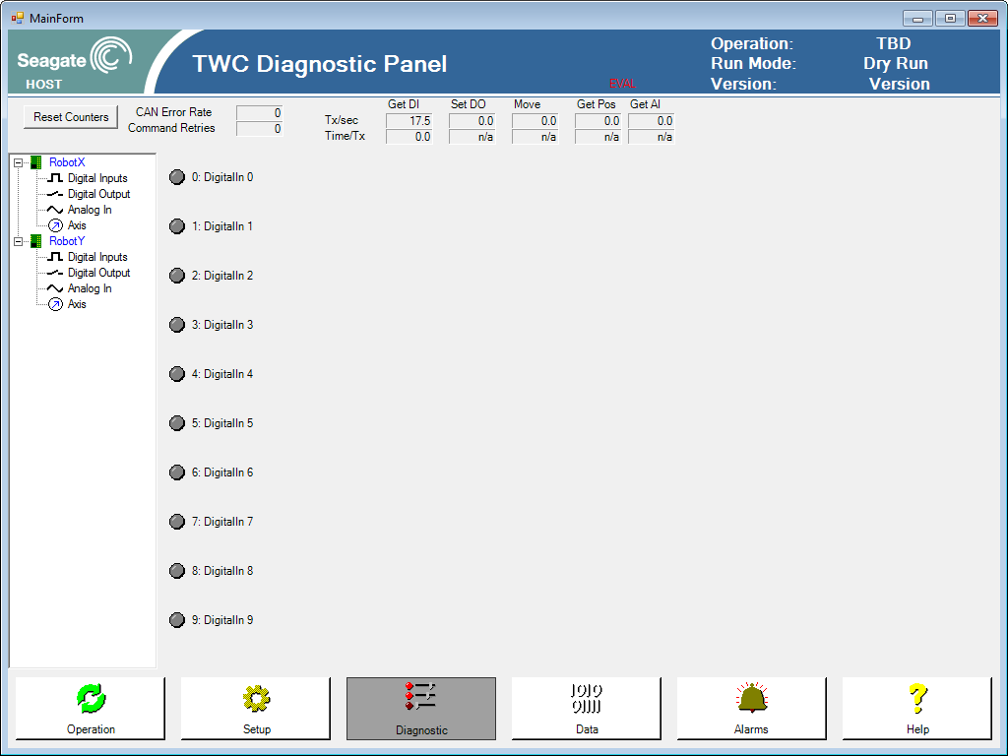
Test
Run (F5) …
Note
Diagnostic interface now displays the specified number of inputs, outputs, and axis
If physical equipment was attached, we should be able to control those IO’s
Understand registration and hardware initialization process.
IO’s have no names … yet
Next
Assign names to IO’s

Slide 52
End Day 4 part 2

Slide 53
Enumerate IO
using System;
using System.Collections.Generic;
using System.Linq;
using System.Text;
namespace Seagate.AAS.Falcon.TrainingApp
{
public class TrainingIoManifest : Seagate.AAS.Parsel.Hw.IOManifest
{
public enum DigitalInput
{
VacuumSensed,
EeExtended,
EeRetracted,
DrivePresent
}
public enum DigitalOutput
{
VacuumOn,
ExtendEe,
RetractEe,
ReleaseDrive
}
public enum Axis
{
Y
}
public override void RegisterIOs()
{
Seagate.AAS.Parsel.Hw.Copley.CopleyHC copley = (Seagate.AAS.Parsel.Hw.Copley.CopleyHC)TrainingMachine.Instance.HwSystem.GetHwComponent(0);
uint node = 0;
copley.IOStore.RegisterAmpNode("RobotY", node, 16, 16, 1, 1);
RegisterDigitalInput(copley.IOStore.GetDigitalInput(node, 0), (int)DigitalInput.VacuumSensed, "VacuumSensed");
RegisterDigitalInput(copley.IOStore.GetDigitalInput(node, 1), (int)DigitalInput.EeExtended, "EeExtended ");
RegisterDigitalInput(copley.IOStore.GetDigitalInput(node, 2), (int)DigitalInput.EeRetracted, "EeRetracted ");
RegisterDigitalInput(copley.IOStore.GetDigitalInput(node, 3), (int)DigitalInput.DrivePresent, "DrivePresent");
RegisterDigitalOutput(copley.IOStore.GetDigitalOutput(node, 0), (int)DigitalOutput.VacuumOn, "VacuumOn ");
RegisterDigitalOutput(copley.IOStore.GetDigitalOutput(node, 1), (int)DigitalOutput.ExtendEe, "ExtendEe ");
RegisterDigitalOutput(copley.IOStore.GetDigitalOutput(node, 2), (int)DigitalOutput.RetractEe, "RetractEe ");
RegisterDigitalOutput(copley.IOStore.GetDigitalOutput(node, 3), (int)DigitalOutput.ReleaseDrive, "ReleaseDrive");
RegisterAxis(copley.IOStore.GetAxis(node, 0), (int)Axis.Y, "Y Axis");
}
}
}
IoManifest Lists and Defines IO Map
Physical IO has physical location
In software, we want to refer to IO’s with names that indicate its function.
Registering IO’s in IoManifest relates physical IO location to IO name.
Edit TrainingIoManifest.cs
Examples
RegisterDigitalInput(iai.IOStore.GetDigitalInput(0), (int)DigitalInputs.VacuumSensed, "Vacuum Sensed");
RegisterDigitalOutput(iai.IOStore.GetDigitalOutput(0), (int)DigitalOutputs.VacuumOn, "Vacuum On");
RegisterAxis(iai.IOStore.GetAxis(0), (int)Axis.YAxis, "Y Axis");

Slide 54
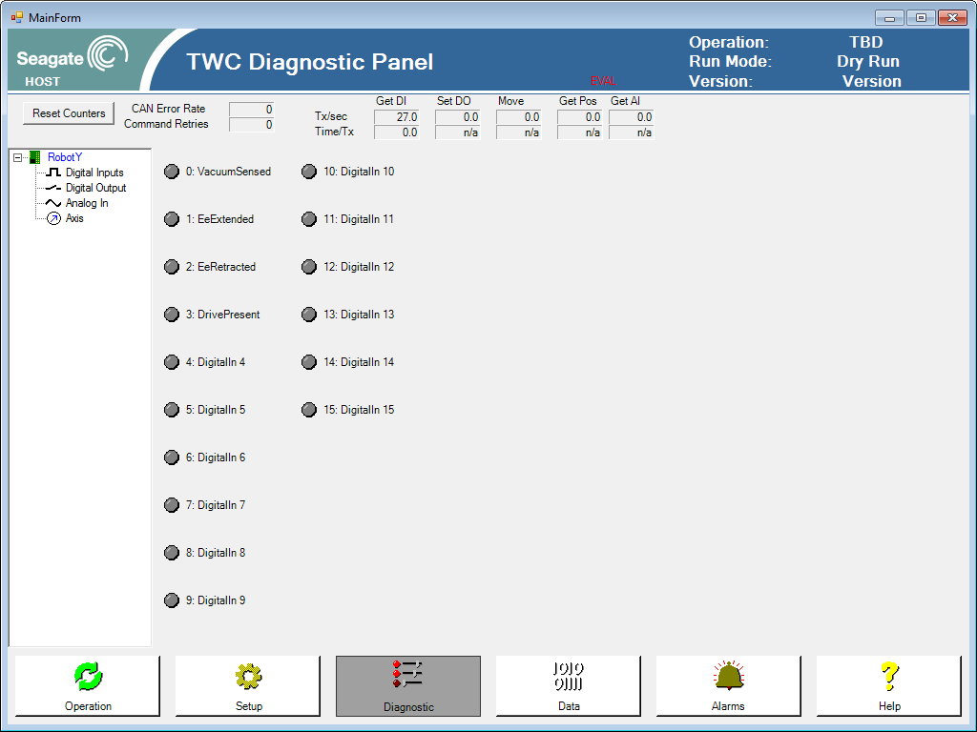
Test
Run (F5) …
Note
IO names appear in diagnostic interface
Unnamed IO’s still visible and can be controlled
Next
Let’s add a IoManifest control and see the difference

Slide 55
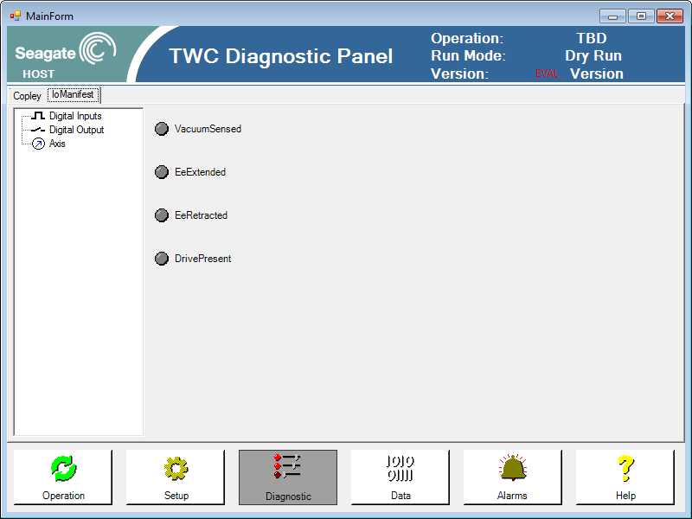
Add IoManifest IoList
Edit Diagnostic Panel
Add TabControl
Move Copley IoList to one tab page
Create IoManifest IoList in another tab page
Assign IoManifest to IoManifest IoList
Edit Workcell.IOManifest property to return IoManifest
public partial class PanelDiagnostics : UserControl
{
TrainingWorkcell workcell;
public PanelDiagnostics(TrainingWorkcell workcell)
{
InitializeComponent();
this.workcell = workcell;
Seagate.AAS.Parsel.Hw.Copley.CopleyHC copley = (Seagate.AAS.Parsel.Hw.Copley.CopleyHC)TrainingMachine.Instance.HwSystem.GetHwComponent(0);
panelIOListTouchscreen1.AssignCopleyHC(copley);
panelIOManifestTouchscreen1.AssignIOManifest(workcell.IOManifest);
}
}
public override Parsel.Hw.IOManifest IOManifest
{
get
{
return _ioManifest;
}
}

Slide 56
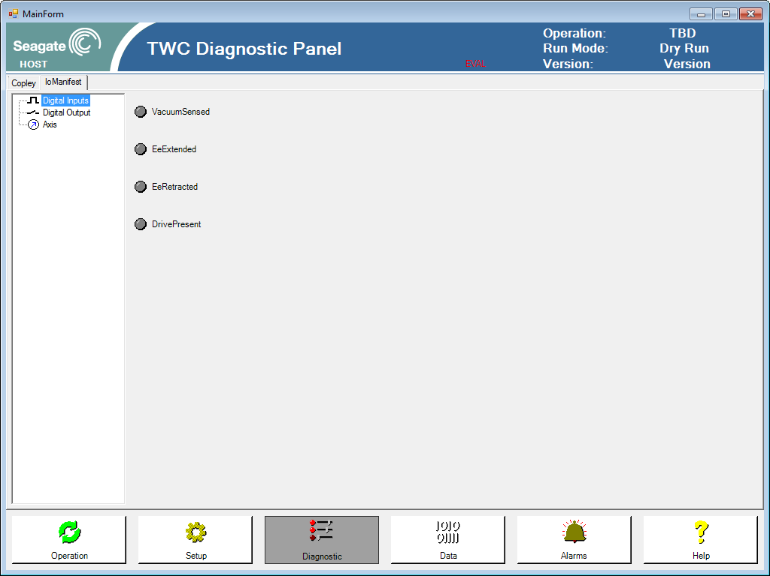
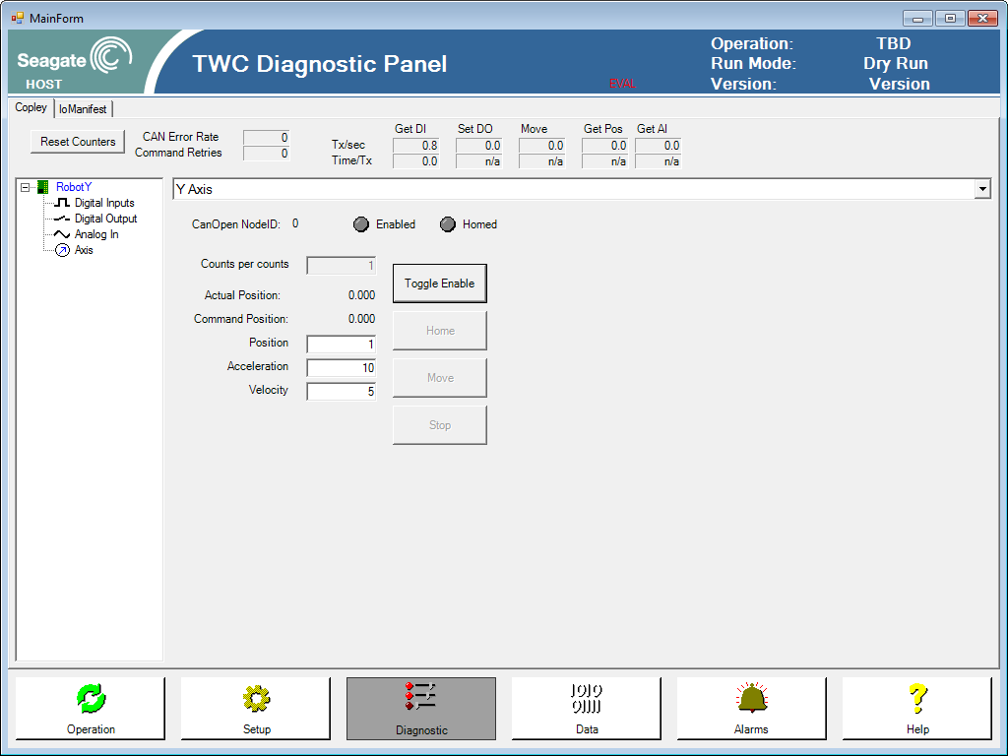
Test
Run (F5) …
Note
IoManifest IO list contains only used IO’s
Differences between IO Interface
IoManifest uses generic IO interface
Copley uses hardware specific IO interface which has CAN messaging statistics
Next
Let’s add controllers next

Slide 57
End Day 4 part 3

Slide 58
ConveyorController
using System;
using System.Collections.Generic;
using System.Linq;
using System.Text;
using Seagate.AAS.Parsel.Hw;
namespace Seagate.AAS.Falcon.TrainingApp
{
public class ConveyorController
{
TrainingWorkcell workcell;
IDigitalOutput releaseDrive;
IDigitalInput drivePresent;
public ConveyorController(TrainingWorkcell workcell)
{
this.workcell = workcell;
releaseDrive = workcell.IOManifest.GetDigitalOutput((int)TrainingIoManifest.DigitalOutput.ReleaseDrive);
drivePresent = workcell.IOManifest.GetDigitalInput((int)TrainingIoManifest.DigitalInput.DrivePresent);
}
public bool ReleaseDrive()
{
bool driveReleased = false;
releaseDrive.Set(DigitalIOState.On);
System.Threading.Thread.Sleep(100);
try
{
drivePresent.WaitForState(DigitalIOState.Off, 5000);
driveReleased = true;
}
catch
{
driveReleased = false;
}
releaseDrive.Set(DigitalIOState.Off);
return driveReleased;
}
public bool GetNextDrive()
{
bool gotDrive = false;
releaseDrive.Set(DigitalIOState.On);
System.Threading.Thread.Sleep(100);
try
{
drivePresent.WaitForState(DigitalIOState.On, 5000);
gotDrive = true;
}
catch
{
gotDrive = false;
}
releaseDrive.Set(DigitalIOState.Off);
return gotDrive;
}
}
}
Controllers manipulate IO’s to execute macro operations
Create ConveyorController.cs
Add using Seagate.AAS.Parsel.Hw;
Inject workcell reference in constructor
Get IO references from IoManifest
Use IO and implement ReleaseDrive() and GetNextDrive()

Slide 59
ConveyorController
using System;
using System.Collections.Generic;
using System.Linq;
using System.Text;
using qf4net;
namespace Seagate.AAS.Falcon.TrainingApp
{
public class Conveyor : Seagate.AAS.Parsel.Equipment.ActiveProcess
{
TrainingWorkcell _workcell;
private QState stateGetNextDrive;
private QState stateWaitPlaceDone;
private QState stateReleaseDrive;
internal ConveyorController controller = null;
public Conveyor(TrainingWorkcell workcell)
: base(workcell)
{
_workcell = workcell;
stateGetNextDrive = new QState(this.GetNextDrive );
stateWaitPlaceDone = new QState(this.WaitPlaceDone);
stateReleaseDrive = new QState(this.ReleaseDrive );
}
protected override void InitializeStateMachine()
{
QF.Instance.Subscribe(this, TrainingSignals.PartPlaced);
base.InitializeStateMachine();
}
public override void Start(int priority)
{
controller = new ConveyorController(_workcell);
base.Start(priority);
}
protected override QState StateActive(IQEvent qEvent)
{
if (qEvent.IsSignal(TrainingSignals.PartPlaced))
{
AddDeferredSignal(qEvent);
return null;
}
return base.StateActive(qEvent);
}
protected override QState StateRunInit(qf4net.IQEvent qEvent)
{
if (qEvent.IsSignal(SigStateJob))
{
TransitionTo(stateGetNextDrive);
return null;
}
return stateProcess;
}
protected QState GetNextDrive(qf4net.IQEvent qEvent)
{
LogMessage("GetNextDrive", qEvent);
if (qEvent.IsSignal(SigStateJob))
{
try
{
// do work
controller.GetNextDrive();
LogMessage("*** publish DriveReady");
QF.Instance.Publish(new QEvent(TrainingSignals.DriveReady));
}
catch (Exception ex)
{
TransitionToErrorState(ex);
return null;
}
TransitionTo(stateWaitPlaceDone);
return null;
}
return stateProcess;
}
protected QState WaitPlaceDone(qf4net.IQEvent qEvent)
{
LogMessage("WaitPlaceDone", qEvent);
if (qEvent.IsSignal(SigStateJob))
{
RecallDeferredSignal(TrainingSignals.PartPlaced);
return null;
}
if (qEvent.IsSignal(TrainingSignals.PartPlaced))
{
LogMessage("*** received PartPlaced");
TransitionTo(stateReleaseDrive);
return null;
}
return stateProcess;
}
protected QState ReleaseDrive(qf4net.IQEvent qEvent)
{
if (qEvent.IsSignal(SigStateJob))
{
try
{
controller.ReleaseDrive();
}
catch (Exception ex)
{
TransitionToErrorState(ex);
return null;
}
TransitionTo(stateGetNextDrive);
return null;
}
return stateProcess;
}
}
}
Add Controller to Conveyor Active Process
Add controller as member variable with internal access
Override Start and Instantiate controller (prevents hw access before hwsystem is initialized)
Add macro functions to appropriate States with try catch error handling

Slide 60
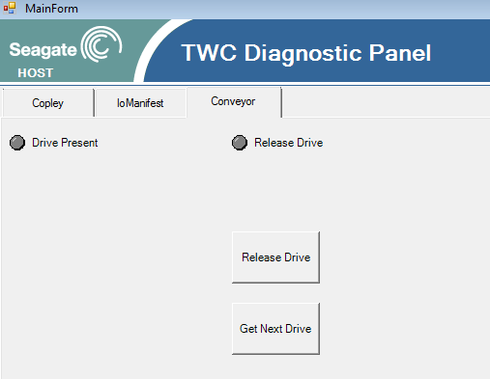
ConveyorController
using System;
using System.Collections.Generic;
using System.ComponentModel;
using System.Drawing;
using System.Data;
using System.Linq;
using System.Text;
using System.Windows.Forms;
namespace Seagate.AAS.Falcon.TrainingApp
{
public partial class PanelDiagnosticsConveyor : UserControl
{
TrainingWorkcell workcell;
public PanelDiagnosticsConveyor()
{
InitializeComponent();
}
public void AssignWorkcell(TrainingWorkcell workcell)
{
this.workcell = workcell;
}
private void timer1_Tick(object sender, EventArgs e)
{
try
{
if (!this.Visible)
{
timer1.Enabled = false;
return;
}
ledReleaseDrive.State = workcell.IOManifest.GetDigitalOutput((int)TrainingIoManifest.DigitalOutput.ReleaseDrive).Get() == Seagate.AAS.Parsel.Hw.DigitalIOState.On;
ledDrivePresent.State = workcell.IOManifest.GetDigitalInput((int)TrainingIoManifest.DigitalInput.DrivePresent).Get() == Seagate.AAS.Parsel.Hw.DigitalIOState.On;
}
catch
{
}
}
private void PanelDiagnosticsConveyor_VisibleChanged(object sender, EventArgs e)
{
if (this.Visible)
timer1.Enabled = true;
}
private void buttonReleaseDrive_Click(object sender, EventArgs e)
{
try
{
workcell.Conveyor.controller.ReleaseDrive();
}
catch
{
}
}
private void buttonGetNextDrive_Click(object sender, EventArgs e)
{
try
{
workcell.Conveyor.controller.GetNextDrive();
}
catch
{
}
}
}
}
public PanelDiagnostics(TrainingWorkcell workcell)
{
InitializeComponent();
this.workcell = workcell;
Seagate.AAS.Parsel.Hw.Copley.CopleyHC copley = (Seagate.AAS.Parsel.Hw.Copley.CopleyHC)TrainingMachine.Instance.HwSystem.GetHwComponent(0);
panelIOListTouchscreen1.AssignCopleyHC(copley);
panelIOManifestTouchscreen1.AssignIOManifest(workcell.IOManifest);
panelDiagnosticsConveyor1.AssignWorkcell(workcell);
}
Create PanelDiagnosticsConveyor.cs
Inject workcell reference
Add 2 Seagate.AAS.UI.Led
Add 2 buttons to execute macros
Add workcell Conveyor and Robot properties to facilitate access
Add timer to display live IO view
Enable timer based on visibility
Edit PanelDiagnostics
Add new Conveyor Tab
Add PanelDiagnosticsConveyor to new tab
Assign workcell reference

Slide 61
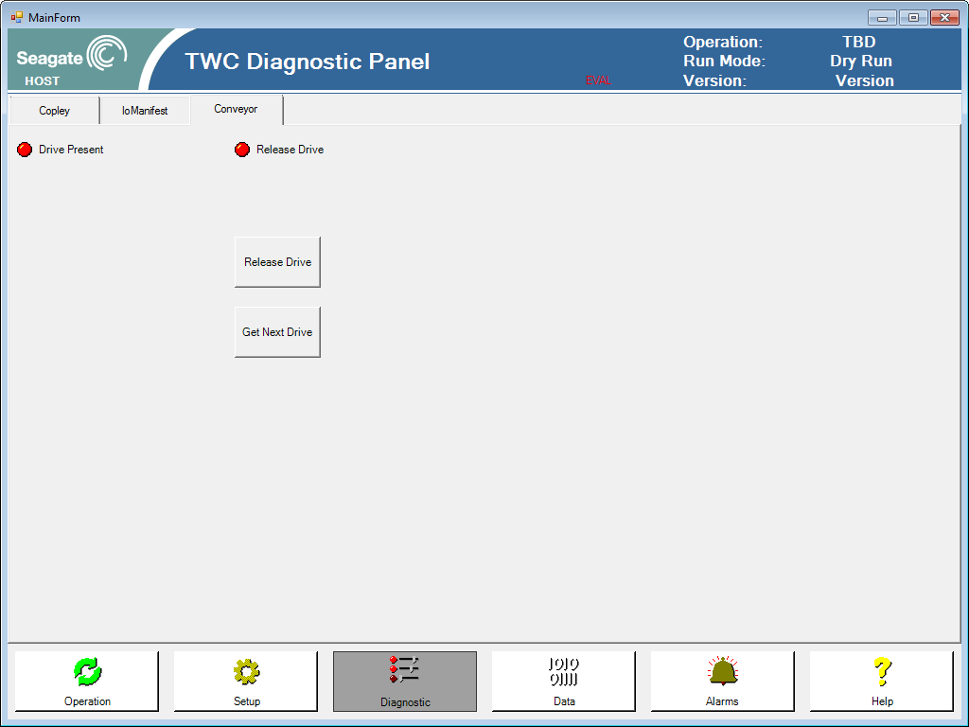
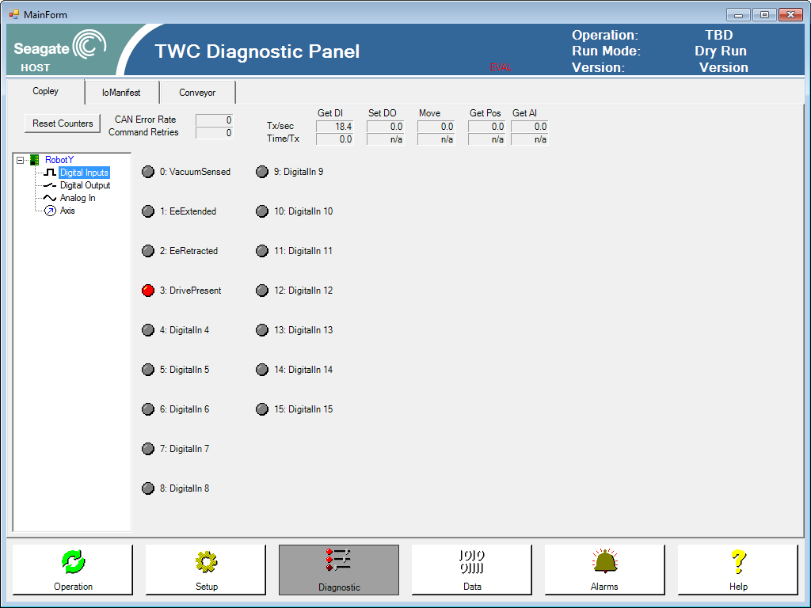
Test
Run (F5) …
Note
See diagnostic interface work
Run operation
See diagnostic interface change simultaneously
Discuss how this behavior is enabled
Add time delay to see better
Next
Learn about devices
Create Robot controllers and use devices

Slide 62
End Day 4 part 4

Slide 63
Robot Controller
using System;
using System.Collections.Generic;
using System.Linq;
using System.Text;
using Seagate.AAS.Parsel.Hw;
using Seagate.AAS.Parsel.Device.PneumaticControl;
namespace Seagate.AAS.Falcon.TrainingApp
{
public class RobotController
{
TrainingWorkcell workcell;
IDigitalOutput extendEe;
IDigitalOutput retractEe;
IDigitalOutput vacuumOn;
IDigitalInput vacuumSensed;
IDigitalInput eeExtended;
IDigitalInput eeRetracted;
IAxis axis;
internal LinearActuator actuator;
public RobotController(TrainingWorkcell workcell)
{
this.workcell = workcell;
vacuumOn = workcell.IOManifest.GetDigitalOutput((int)TrainingIoManifest.DigitalOutput.VacuumOn);
vacuumSensed = workcell.IOManifest.GetDigitalInput((int)TrainingIoManifest.DigitalInput.VacuumSensed);
axis = workcell.IOManifest.GetAxis((int)TrainingIoManifest.Axis.Y);
// create actuator
IDigitalInput eeRetracted = workcell.IOManifest.GetDigitalInput((int)TrainingIoManifest.DigitalInput.EeRetracted);
IDigitalInput eeExtended = workcell.IOManifest.GetDigitalInput((int)TrainingIoManifest.DigitalInput.EeExtended);
IDigitalOutput extendEe = workcell.IOManifest.GetDigitalOutput((int)TrainingIoManifest.DigitalOutput.ExtendEe);
IDigitalOutput retractEe = workcell.IOManifest.GetDigitalOutput((int)TrainingIoManifest.DigitalOutput.RetractEe);
actuator = new LinearActuator(extendEe, retractEe, eeExtended, eeRetracted);
actuator.Name = "EE Actuator";
}
public bool PickPart()
{
bool partPicked = false;
System.Threading.Thread.Sleep(100);
axis.MoveAbsolute(100, 100, 50, 10000);
actuator.Extend(5000);
vacuumOn.Set(DigitalIOState.On);
try
{
vacuumSensed.WaitForState(DigitalIOState.On, 5000);
partPicked = true;
}
catch
{
partPicked = false;
}
actuator.Retract(5000);
return partPicked;
}
public bool PlacePart()
{
bool partPlaced = false;
System.Threading.Thread.Sleep(100);
axis.MoveAbsolute(100, 100, 100, 10000);
actuator.Extend(5000);
vacuumOn.Set(DigitalIOState.Off);
try
{
System.Threading.Thread.Sleep(100);
vacuumSensed.WaitForState(DigitalIOState.Off, 5000);
partPlaced = true;
}
catch
{
partPlaced = false;
}
actuator.Retract(5000);
return partPlaced;
}
}
}
Add Project and Reference to
Seagate.AAS.Parsel.Device.PneumaticControl
Create RobotController.cs
Copy and edit ConveyorController
Add using Seagate.AAS.Parsel.Device.PneumaticControl;
Add vacuumSensed and vacuumOn
Create LinearActuator member and instantiate in constructor
Create PickPart() and PlacePart()

Slide 64
Robot Controller
using System;
using System.Collections.Generic;
using System.Linq;
using System.Text;
using qf4net;
namespace Seagate.AAS.Falcon.TrainingApp
{
public class Robot : Seagate.AAS.Parsel.Equipment.ActiveProcess
{
TrainingWorkcell _workcell;
private QState statePickPart;
private QState stateWaitDriveReady;
private QState statePlacePart;
internal RobotController controller;
public Robot(TrainingWorkcell workcell)
: base(workcell)
{
_workcell = workcell;
statePickPart = new QState(this.PickPart);
stateWaitDriveReady = new QState(this.WaitDriveReady);
statePlacePart = new QState(this.PlacePart);
}
protected override void InitializeStateMachine()
{
QF.Instance.Subscribe(this, TrainingSignals.DriveReady);
base.InitializeStateMachine();
}
public override void Start(int priority)
{
controller = new RobotController(_workcell);
base.Start(priority);
}
protected override QState StateActive(IQEvent qEvent)
{
if (qEvent.IsSignal(TrainingSignals.DriveReady))
{
AddDeferredSignal(qEvent);
return null;
}
return base.StateActive(qEvent);
}
protected override QState StateRunInit(qf4net.IQEvent qEvent)
{
if (qEvent.IsSignal(SigStateJob))
{
TransitionTo(statePickPart);
return null;
}
return stateProcess;
}
protected QState PickPart(qf4net.IQEvent qEvent)
{
if (qEvent.IsSignal(SigStateJob))
{
try
{
controller.PickPart();
}
catch (Exception ex)
{
TransitionToErrorState(ex);
return null;
}
TransitionTo(stateWaitDriveReady);
return null;
}
return stateProcess;
}
protected QState WaitDriveReady(qf4net.IQEvent qEvent)
{
if (qEvent.IsSignal(SigStateJob))
{
RecallDeferredSignal(TrainingSignals.DriveReady);
return null;
}
if (qEvent.IsSignal(TrainingSignals.DriveReady))
{
LogMessage("*** received DriveReady");
TransitionTo(statePlacePart);
return null;
}
return stateProcess;
}
protected QState PlacePart(qf4net.IQEvent qEvent)
{
LogMessage("PlacePart", qEvent);
if (qEvent.IsSignal(SigStateJob))
{
try
{
controller.PlacePart();
LogMessage("*** publish PartPlaced");
QF.Instance.Publish(new QEvent(TrainingSignals.PartPlaced));
}
catch (Exception ex)
{
TransitionToErrorState(ex);
return null;
}
TransitionTo(statePickPart);
return null;
}
return stateProcess;
}
}
}
Add controller to Robot Active Process
Add controller as member variable with internal access
Override Start and Instantiate controller (prevents hw access before hwsystem is initialized)
Add macro functions to appropriate States with try catch error handling

Slide 65
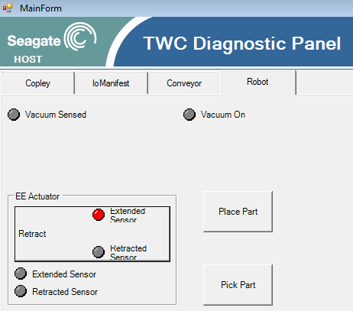
PanelDiagnosticsRobot
Create PanelDiagnosticsRobot
Copy and edit PanelDiagnositcsConveyor
Edit designer partial class also!
Add Pneumatic Actuator UI
Inject reference
Edit Panel Diagnostics
Add robot tab
Add PanelDiagnosticsRobot to new tab
Inject workcell reference
public void AssignWorkcell(TrainingWorkcell workcell)
{
this.workcell = workcell;
pneumaticControlUI1.AssignActuator(workcell.Robot.controller.actuator);
}
public partial class PanelDiagnostics : UserControl
{
TrainingWorkcell workcell;
public PanelDiagnostics(TrainingWorkcell workcell)
{
InitializeComponent();
this.workcell = workcell;
Seagate.AAS.Parsel.Hw.Copley.CopleyHC copley = (Seagate.AAS.Parsel.Hw.Copley.CopleyHC)TrainingMachine.Instance.HwSystem.GetHwComponent(0);
panelIOListTouchscreen1.AssignCopleyHC(copley);
panelIOManifestTouchscreen1.AssignIOManifest(workcell.IOManifest);
panelDiagnosticsConveyor1.AssignWorkcell(workcell);
panelDiagnosticsRobot1.AssignWorkcell(workcell);
}
}

Slide 66
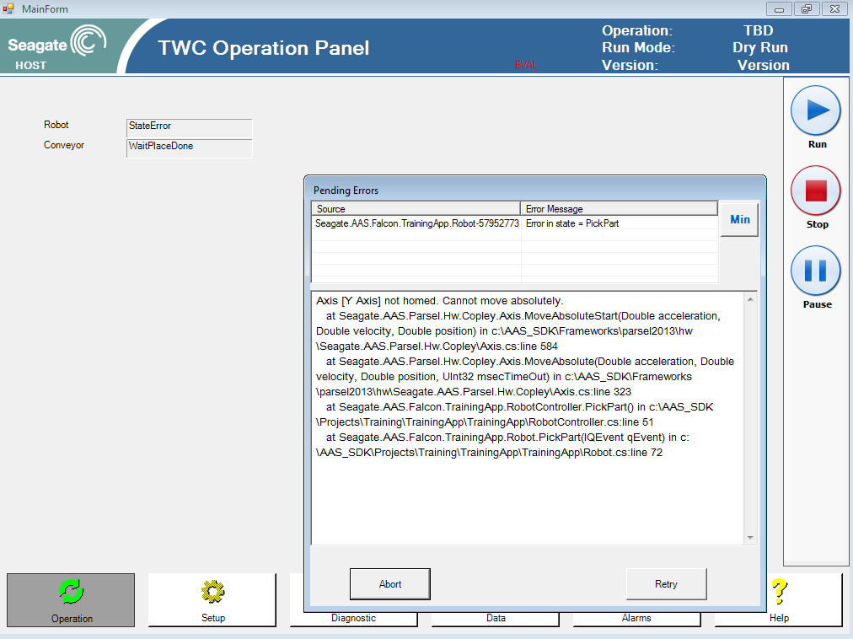
Test
Run (F5) …
Note
Go to robot diagnostics
Try actuator interface
Try to pick part…see error
Run operation
See error state when trying to pick part
Discuss how this behavior is enabled
Manually home and try again
Next
Add homing to RunInit

Slide 67
Change Robot Run Init
RobotController…
public void RunInit()
{
actuator.Retract(5000);
if (!axis.IsHomed)
axis.Home(10000);
axis.MoveAbsolute(100, 100, 0, 10000);
}
Add Homing to controller
Add Homing to Run Init
RobotController…
protected override QState StateRunInit(qf4net.IQEvent qEvent)
{
if (qEvent.IsSignal(SigStateJob))
{
try
{
controller.RunInit();
}
catch (Exception ex)
{
TransitionToErrorState(ex);
return null;
}
TransitionTo(statePickPart);
return null;
}
return stateProcess;
}

Slide 68
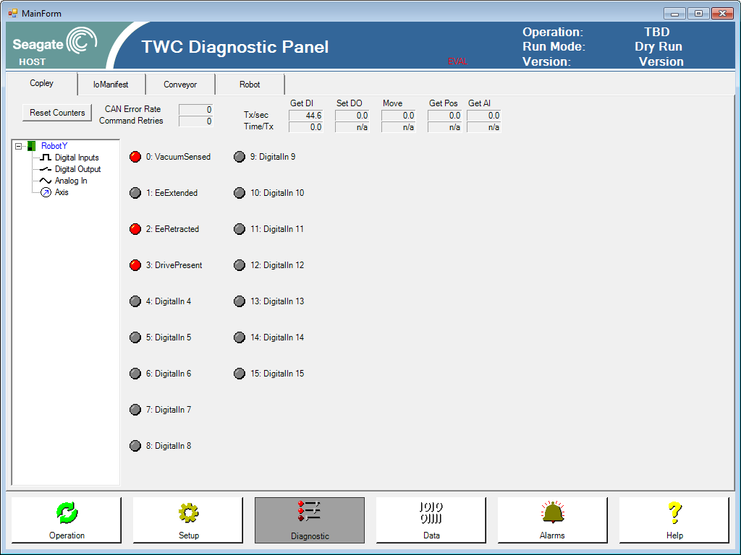
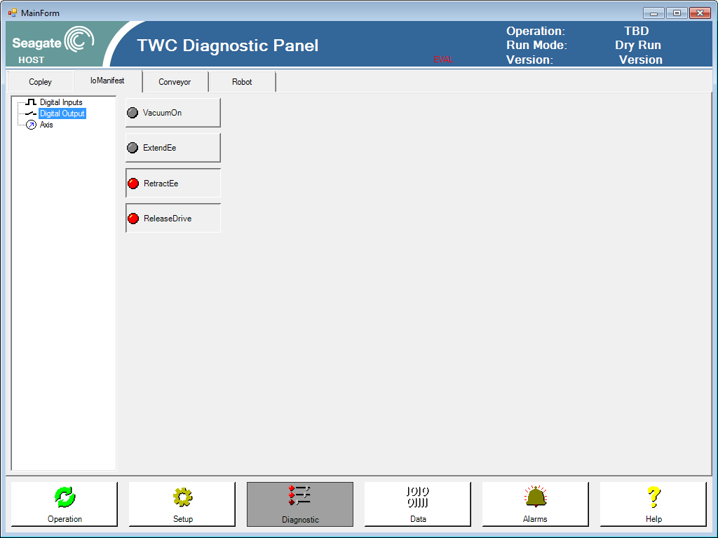
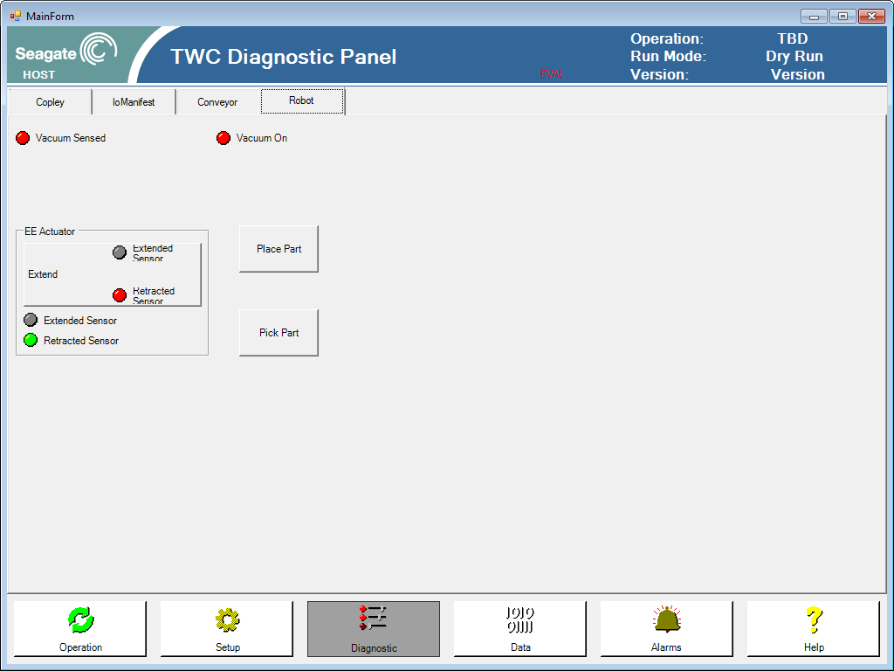
Test
Run (F5) …
Note
Run operation
No more error state
See Diagnostic UI during running
Next
Installer

Slide 69
End Day 4 part 5
End of Day 4
End of Training App
Tomorrow
Look at available software components
Look at Skynet API
Design installer
Distribution through website

Slide 70
Day 5
Final Day Agenda
Skynet API
Installer
Fremont Topics
Hardware Provider details
Vision commonality, VisionProcessor
OSC abstraction
Error handling

Slide 71
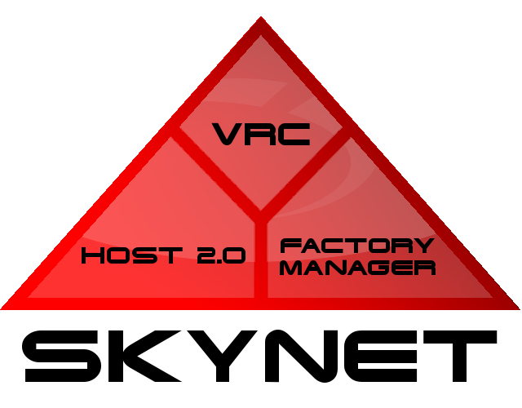
Skynet API
Skynet is a Seagate developed, network-based factory supervisory control and data acquisition system
We will learn how to
Connect to Skynet
Perform Process Qualification
Report Disposition
Shutdown
Link to separate Skynet API Training

Slide 72
Connect to Skynet and Shutdown
Edit TrainingWorkcell
Add using Seagate.AAS.Skynet.HostAPI;
Set connection options
Initialize
Provide unique station ID and line ID
Override Dispose and add SkynetAPI.Shutdown()
using Seagate.AAS.Skynet.HostAPI;
public override void Initialize()
{
// set connection options
SkynetAPI.ConnectionConfig = ConnectionConfigurationTypes.HardCoded_UsingIpAddressProperty;
SkynetAPI.HostIpAddress = "skynet.colo.seagate.com"; // "10.30.138.100";
// other skynet API read only properties: StationName, LineID, IsInitialized, Simulation
SkynetAPI.Simulation = true;
// initialize & connect
string stationId = "Training001";
string lineId = "Line101";
SkynetAPI.Initialize(stationId, lineId);
_ioManifest = new TrainingIoManifest();
TrainingMachine.Instance.HwSystem.RegisterIOManifest(_ioManifest);
activeProcesses.Add("Conveyor", new Conveyor(this));
activeProcesses.Add("Robot", new Robot(this));
}
public override void Dispose()
{
SkynetAPI.Shutdown();
base.Dispose();
}

Slide 73
Get Host Interface
Edit Conveyor.cs
Get Host Interface in constructor
Seagate.AAS.Skynet.HostAPI.Falcon.IFalconHost _host = null;
public Conveyor(TrainingWorkcell workcell)
: base(workcell)
{
_workcell = workcell;
// get host interface
_host = Seagate.AAS.Skynet.HostAPI.SkynetAPI.GetFalconHostInterface("TWC");
stateGetNextDrive = new QState(this.GetNextDrive );
stateWaitPlaceDone = new QState(this.WaitPlaceDone);
stateReleaseDrive = new QState(this.ReleaseDrive );
}

Slide 74
Process Qualification
Edit GetNextDrive state in Conveyor.cs
Do proqual and transition to the appropriate next state
bool processingDrive = false;
protected QState GetNextDrive(qf4net.IQEvent qEvent)
{
LogMessage("GetNextDrive", qEvent);
if (qEvent.IsSignal(SigStateJob))
{
try
{
// do work
controller.GetNextDrive();
// perform process qualifiation
Seagate.AAS.Skynet.HostAPI.Falcon.FalconDriveProQual pq = _host.GetDriveProQual("1TC00001", Skynet.HostAPI.DriveIdentifierTypes.HDASerialNumber);
processingDrive = (pq.ProQualResult == Skynet.HostAPI.ProQualResultTypes.ReadyToProcess);
if (processingDrive)
{
LogMessage("*** publish DriveReady");
QF.Instance.Publish(new QEvent(TrainingSignals.DriveReady));
TransitionTo(stateWaitPlaceDone);
return null;
}
else
{
LogMessage("<<< drive failed proQual");
TransitionTo(stateReleaseDrive);
return null;
}
}
catch (Exception ex)
{
TransitionToErrorState(ex);
return null;
}
}
return stateProcess;
}

Slide 75
Report Disposition
Edit ReleaseDrive state in Conveyor.cs
Add code to report data to host
protected QState ReleaseDrive(qf4net.IQEvent qEvent)
{
if (qEvent.IsSignal(SigStateJob))
{
try
{
// report data if drive was processed
if (processingDrive)
{
// instantiate FalconDriveDisposition
FalconDriveDisposition dispo = new FalconDriveDisposition();
dispo.SetDriveIdentifier("1TC00001", Skynet.HostAPI.DriveIdentifierTypes.HDASerialNumber);
dispo.CompletedOperation = _host.StationID;
// report fail code, convey time, process time
dispo.FailCode.Code = 0;
dispo.ConveyTime_ms = 0.5;
dispo.ProcessTime_ms = 3.5;
// add data collected
dispo.AttributeData.Add("TestData", "TestValue");
_host.SendDriveDisposition(dispo);
}
controller.ReleaseDrive();
}
catch (Exception ex)
{
TransitionToErrorState(ex);
return null;
}
TransitionTo(stateGetNextDrive);
return null;
}
return stateProcess;
}

Slide 76
Test
Run (F5) …
Note
Run operation
Can turn simulation off and see actual connection to host
Next
Installer

Slide 77
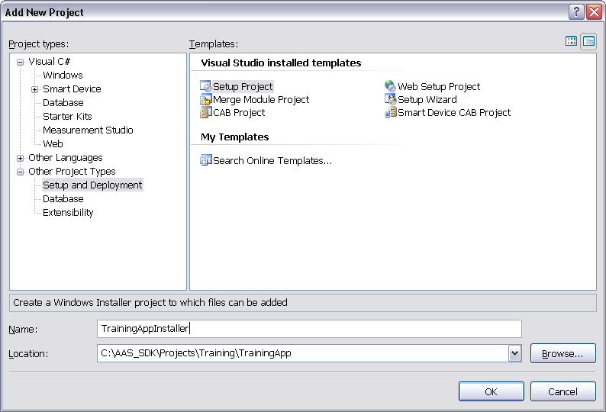
Installer
(needs VS2013 update)
Solution
Add New Project
Project Type: Setup and Deployment
Template: Setup Project

Slide 78
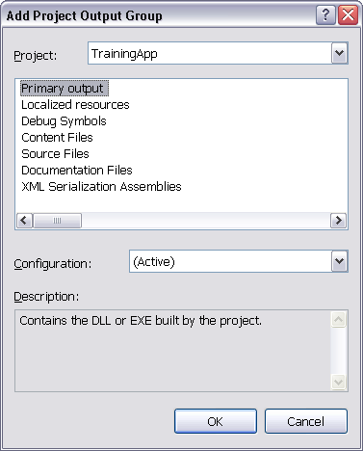
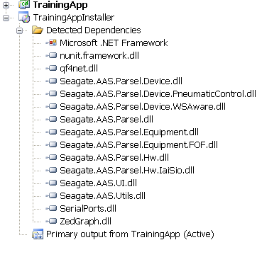
Add TrainingApp Primary Output
(needs VS2013 update)
Add-Project Output
Select TrainingApp
Primary output
Localized resources
(if multi-language enabled)
Debug output (optional)
See detected dependencies

Slide 79
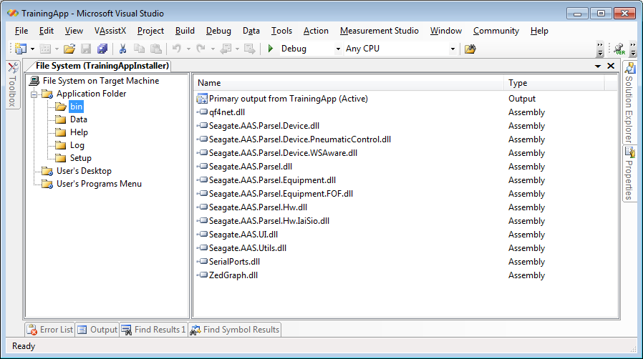
Installer
(needs VS2013 update)
View-File System
Edit Application Folder
Add bin, Setup, Data, Log, Help
Move binaries to bin directory
Move TrainingApp Primary output and dependencies to Application Folder/bin directory
Make shortcut on desktop
Right click on Primary output and select Create Shortcut…
Rename shortcut to TrainingApp
Move shortcut to User’s Desktop folder

Slide 80
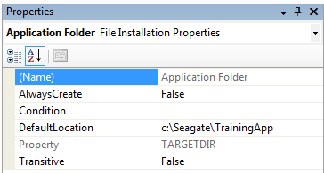
Test Installer
(needs VS2013 update)
Right click on TrainingAppInstaller
Select Build
Select Install to test installer
See default Application Folder is not correct
Quit Installer
Edit properties of Application Folder
Change Default Location to c:\Seagate\TrainingApp
Rebuild Installer and test
Run installed TestApp from desktop

Slide 81
References

Slide 82
Repository State
Training updated on 11/10/2014 used the following repository state:
Parsel2013.core = 134
Parsel2013.device = 83
Parsel2013.hw = 81
Parsel2013.skynet = 81
Training source code available in SVN
http://seaforge.nrm.minn.seagate.com/websvn/listing.php?repname=hda.falcon.training&path=%2F&sc=0

